Slide 1
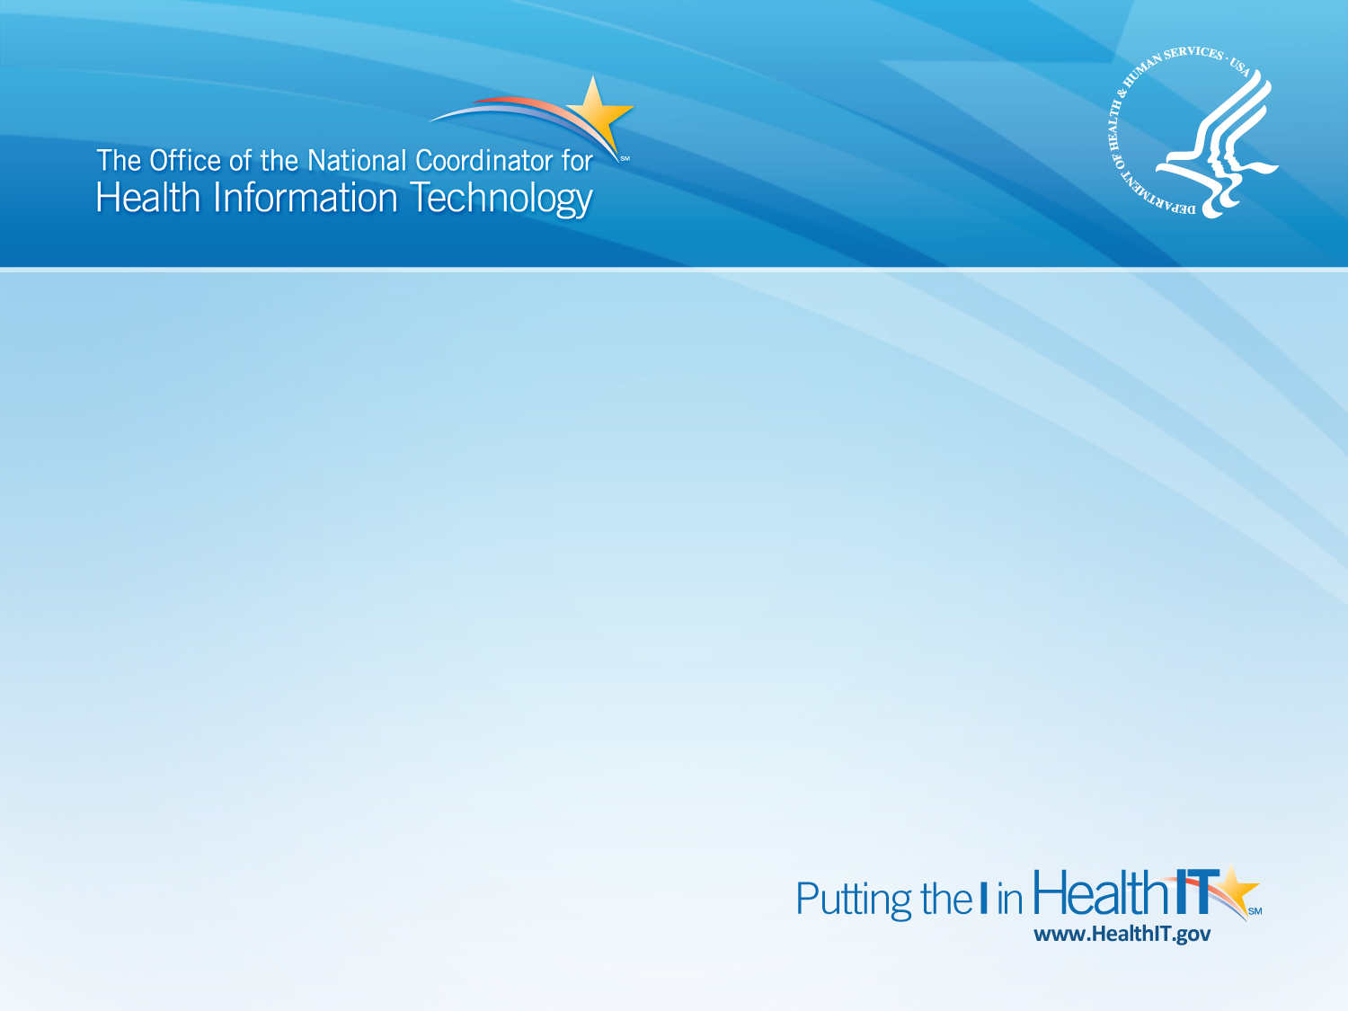
Electronic Measurement in the Real World: Lessons Learned from the Beacon Communities
StrataRx Conference
Kerri Petrin, MPH
Project Officer, Beacon Community Program
October 17, 2012

Slide 2
Beacon Communities are Bringing
HITECH to Life
Why does America need to modernize using Health IT?
What is America doing to modernize its Healthcare System through Health IT?
Enable providers to securely and efficiently exchange patient health information.
Give providers the right information, at the right time to offer their patients the right care.
Give consumers tools to know their health information so that they can improve their health.
Foundational to building a truly 21st century health system where we pay for the right care, not just more care.
Showing Outcomes
Engaging Consumers
Promoting Exchange
Keeping Patients Safe
Protecting Privacy and Security
Accelerating Meaningful Use
2012
Helping Providers Adopt (MU, REC, Workforce)
Standards & Interoperability (S&I Framework, HIE)
Testing & Showing How the Pieces Fit Together (Beacon)
How is ONC helping?

Slide 3
Beacon Community Aims
17 grantees each funded ~$12-16M over 3 yrs to:
Build and strengthen health IT infrastructure and exchange capabilities - positioning each community to pursue a new level of sustainable health care quality and efficiency over the coming years.
Improve cost, quality, and population health - translating investments in health IT in the short run to measureable improvements in the 3-part aim.
Test innovative approaches to performance measurement, technology integration, and care delivery - accelerating evidence generation for new approaches.
For more information, see the AcademyHealth brief, Three Pillars of Pursuit: http://www.healthit.gov/sites/default/files/pdf/beacon-brief-061912.pdf

Slide 4
17 Beacon Communities
Bangor Beacon Community
Brewer, ME
Western New York Beacon Community
Buffalo, NY
Beacon Community of Inland Northwest
Spokane, WA
Southeastern Minnesota Beacon Community
Rochester, MN
Rhode Island Beacon Community
Providence, RI
Southeast Michigan Beacon Community
Detroit, MI
Keystone Beacon Community
Danville, PA
Central Indiana Beacon Community
Indianapolis, IN
Utah Beacon Community
Salt Lake City, UT
Greater Cincinnati Beacon Community
Cincinnati, OH
Colorado Beacon Community
Grand Junction, CO
Southern Piedmont Beacon Community
Concord, NC
Great Tulsa Health Access Network Beacon Community
Tulsa, OK
San Diego Beacon Community
San Diego, CA
Delta BLUES Beacon Community
Stoneville, MS
Hawaii County Beacon Community
Hilo, HI
Crescent City Beacon Community
New Orleans, LA

Slide 5
Panelists
Lori Stephenson, Quality Improvement Director, Rocky Mountain Health Plans, Colorado Beacon Consortium
Dr. Greg Larkin, Indiana State Health Commissioner, Central Indiana Beacon Community
Marilee Benson, VP of Sales, Mirth Corporation, Crescent City Beacon Community
Craig Brammer, Director, Beacon Community Program, ONC

